Slide 1
Unit-3
Memory

Slide 2
Syllabus
Dynamic RAM organization, CACHE memory & it’s mapping, cache organization in multicore Processor, virtual memory, secondary storage, IDE, SCSI, RAID, CD, DVD.

Slide 3
Memory and Its Characteristics
Internal memory (RAM) in a computer is required for execution of a program (instruction and data).
Semi-conductor RAM is present mainly in two forms:
SRAM (used for cache memory / temporary memory)
DRAM ( used for main memory usage)

Slide 4
Compare memory devices and technologies on the basis of:
Storage capacity
Size of memory.
In terms of words or bytes.
Unit of transfer
Number of bits read or written in a single read or write operation.
Depends on data lines. (Train tracks)
Access modes:
Accessing the information from memory.
Ways:
1. Random access : Cache
2. Direct access : Disk/CD-ROM
3. Sequential access: Tape
4. Associative access: Content- addressable memory

Slide 5
Compare memory devices and technologies on the basis of:
Access time:
Time in between the request made for operation and the time when the data is available.
Depends on physical characteristics and access modes.
Permanence of storage:
Loss of information over a period of time.
Destructive failure, volatile data, etc.
Cycle time:
Minimum time elapsed between two consecutive read requests.
Same as access time but includes the refresh cycle time also.
Data transfer rate:
Amount of information transferred per unit time is data transfer rate.
Measured in (bps.)

Slide 6
Physical Characteristics
Type of Memory | Access Modes | Permanence of Storage | Physical Storage
Semiconductor memories | Random | Volatile | Electronic
Magnetic disk | Direct | Non-Volatile | Magnetic
Magnetic disk | Sequential | Non-Volatile | Magnetic
CD-ROM | Direct | Non-Volatile | Optical

Slide 7
Dynamic RAM organization (DRAM)
Dynamic random access memory (DRAM) is a type of semiconductor memory that is typically used for the data or program code needed by a computer processor to function.
High density storage can be achieved using DRAM. As it requires 1bit/ 1 transistor.
DRAM is a common type of random access memory (RAM) used in personal computers (PCs), workstations, and servers.
Integrated RAM chips are available in two forms:
SRAM (Static RAM)
DRAM (Dynamic RAM)

Slide 8
Dynamic random access memory stores each bit of data in a separate capacitor within an integrated circuit. The charging and discharging of the capacitor represent 0 and 1, i.e., the two possible values that can be stored in a bit.
DRAM is widely used in digital electronics where low-cost and high-capacity memory is required.
DRAM will store bits of data in a storage or memory cell, consisting of a capacitor and a transistor.
A DRAM storage cell is dynamic, meaning that it needs to be refreshed or given a new electronic charge every few milliseconds to compensate for charge leaks from the capacitor.

Slide 9
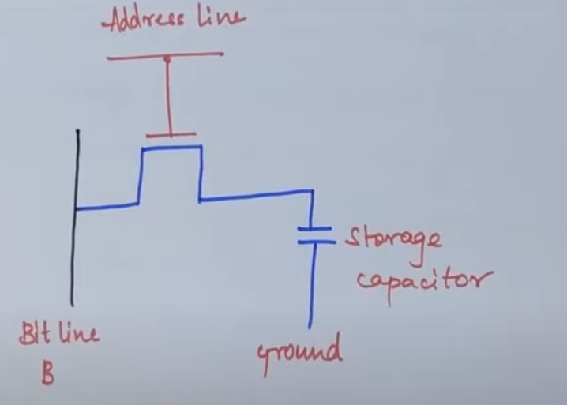

Slide 10
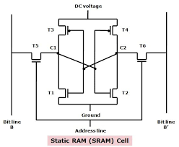

Slide 11
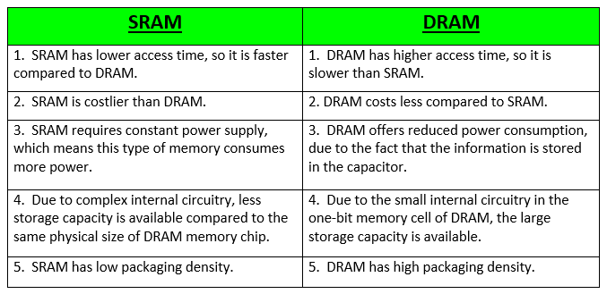

Slide 12
Cache Memory:
Cache Memory is defined as a very high speed memory that is used in computer system to compensate the seed differential between the main memory access time and processor logic.
A very high speed memory called a cache is used to increase the speed of processing by making current programs and data available to the CPU at a rapid rate. It is place between the CPU and the main memory.
The cache memory access time is less than the access time of the main memory by a factor of 5 to 10. The cache is used for storing program segments currently being executed in the CPU and the data frequently used in the present calculations. By making programs and data available at a rapid rate, it is possible to increase the performance rate of a computer.

Slide 13
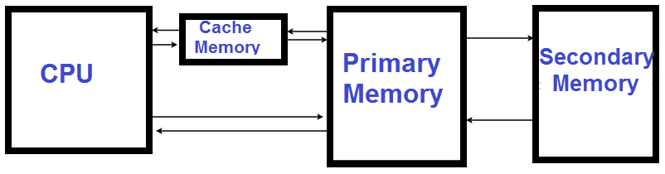
The cache memory is employed in computer systems to compensate for the speed differential between main memory access time and processor logic. CPU logic is usually faster than main memory access time, with the result that processing speed is limited primarily by the speed of main memory.
Figure 1: Cache Memory

Slide 14
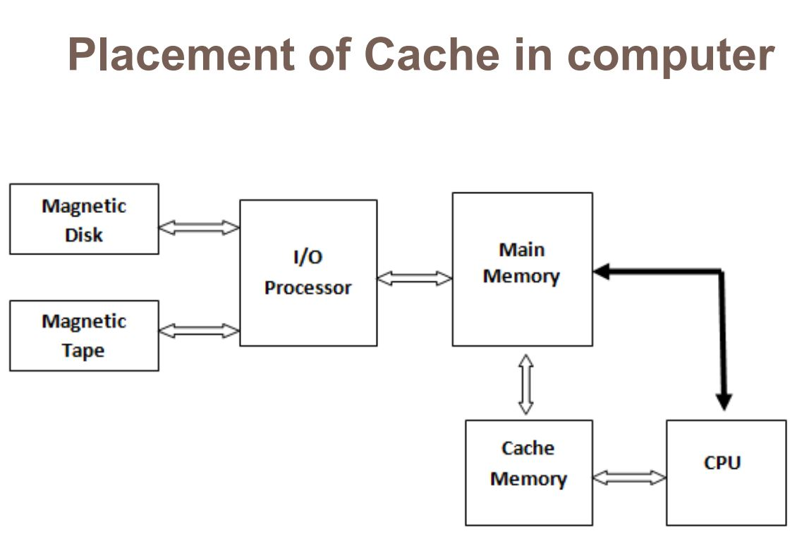
Figure 2: Placement of Cache Memory

Slide 15
Cache Memory:
The references to memory at any given interval of time tend to be confined within a few localized areas in memory. This phenomenon is known as the property of locality of reference.
If the active portions of the program and data are placed in a fast small memory, the average memory access time can be reduced, thus reducing the total execution time of the program. It is placed between the CPU and main memory.
The cache memory access time is less than the access time of main memory by a factor of 5 to 10. The cache is the fastest component in the memory hierarchy and approaches the speed of CPU components.
The basic operation of the cache is as follows. When the CPU needs to access memory, the cache is examined. If the word is found in the cache, it is read from the fast memory. If the word addressed by the CPU is not found in the cache, the main memory is accessed to read the word.
The performance of cache memory is frequently measured in terms of a quantity called hit ratio. When the CPU refers to memory and finds the word in cache, it is said to produce a hit. If the word is not found in cache, it is in main memory and it counts as a miss. The ratio of the number of hits divided by the total CPU references to memory is the hit ratio.

Slide 16
The average memory access time of a computer system can be improved considerably by use of a cache. If the hit ratio is high enough so that most of the time the CPU accesses the cache instead of main memory, the average access time is closer to the access time of the fast cache memory.
The basic characteristic of cache memory is its fast access time. Therefore, very little or no time must be wasted when searching for words in the cache. The transformation of data from main memory to cache memory is referred to as a mapping process.
Three types of mapping procedures are of practical interest when considering the organization of cache memory.
Direct mapping
Associative mapping/ fully associative mapping
3. Set-associative mapping/ k-way associative mapping

Slide 17
1. Direct Mapping:
Address Mapping Methods:
Suppose a computer has 4K main memory i.e. 4x1024 bytes and 1K cache memory. To address a word in the main memory, a 12 bit (4K = 212) address is required. Similarly, to address a word in the cache memory a 10-bit (1K = 210) address is required. Thus, a cache memory needs 10 bits to address a word and main memory requires 12 bits to address a word.
In direct mapping method, the 12 bit address sent by CPU is divided into two parts called tag field and index field. The index field has the number of bits equal to the number of bits required to address a word in cache. Thus, if a computer has main memory of capacity 2m and cache memory of 2n , then the address bits will be divided into n bits index field and (m-n) bits of tag field. The tag field for above computer system will be of 2-bits and index field will have 10 bits.
In a direct mapping method, the cache memory stored the word as well as the tag field. The words will be stored at that location in the cache which is represented by the index fields of their addresses as shown in figure.

Slide 18
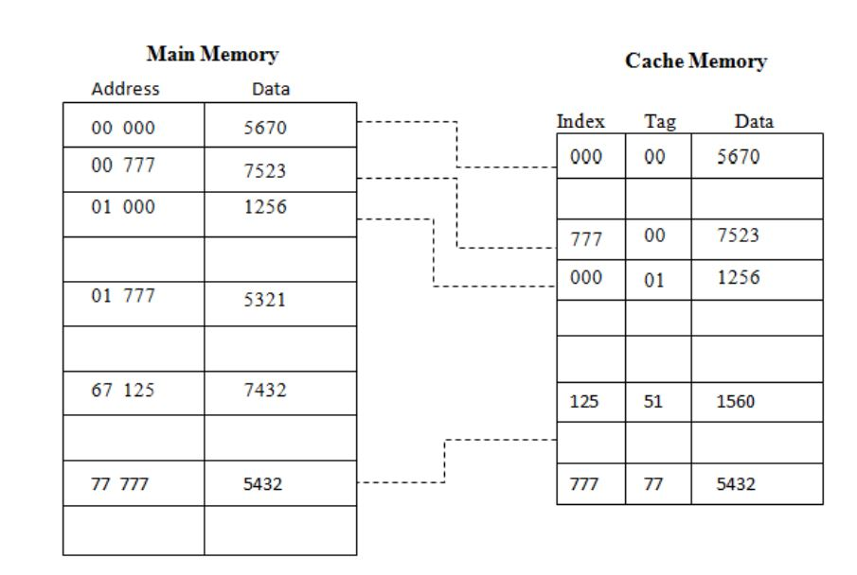
Figure 3: Direct Memory Mapping

Slide 19
When an address is sent by the CPU, the index part of the address is used to get a memory location in the cache.
If the tag stored at that location matches the tag field of the requested address, the word is fetched. Else, if tag does not match, the word is searched in the main memory.
When a word needs to be moved into cache memory from the main memory, its address I the main memory is divided into index and tag fields. The disadvantage of direct mapping is that the hit ratio can drop considerably if two or more words whose addresses have same index but different tags are accessed repeatedly.
The disadvantage of direct mapping is that two words with same index but different tag cannot be stored into cache at the same time. As an improvement to this disadvantage of direct mapping, a third type of cache organization called set-associative mapping is used.

Slide 20
2. Associative Mapping:
In case of associative mapping, the contents of cache memory are not associated with any address.
Data stored in the cache memory are not accessed by specifying any address. Instead, data or part of data is searched by matching with the contents.
In associative mapping method, both the word and the address of the word (in the main memory) are stored in the cache as shown in Figure.

Slide 21
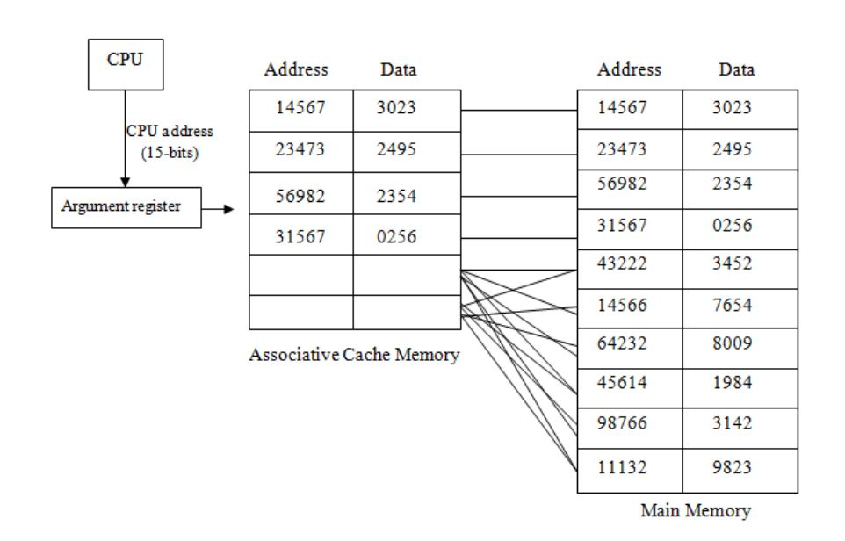
Figure 4: Associative Memory Mapping

Slide 22
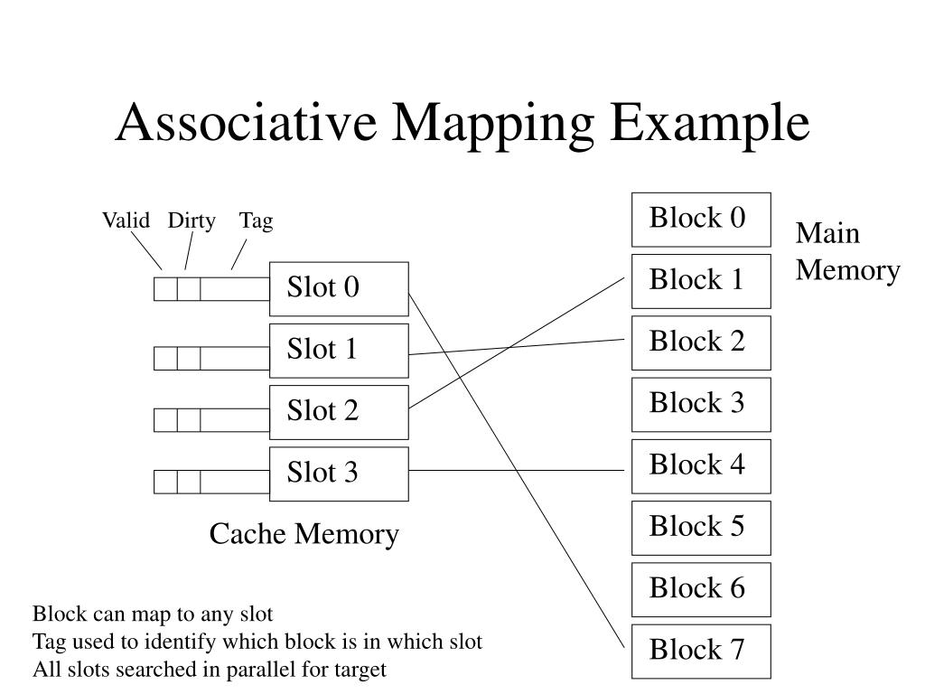

Slide 23
The address bits, sent by the CPU to search, are matched with addresses stored in the cache memory. If any address is matched, the corresponding word is fetched from the cache and sent to the CPU.
If not match is found in cache memory, the word is searched in the main memory. The word along with address is then copied from main memory into cache. If the cache is full, then the existing word along with its address must be removed to make room for the new word.
Associative mapping has the advantage that it is a very fast access method.
It has the disadvantage that it is very expensive and complicated because of complex logical circuits that ate required to implement data searching by content and not by address. Due to the high cost associated with logic circuits required to implement associative mapping, other methods are used in which data is cache memory are accessed by address, like direct mapping and set associative mapping.

Slide 24
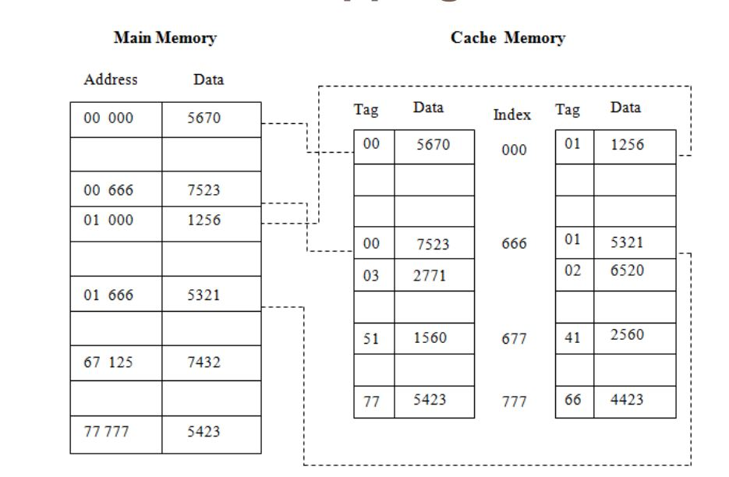
3. Set Associative Mapping
In this mapping process, each word of a cache can store two or more words of main memory under the same index address. Each data word is stored along with its tag and the number of tag data pair in one word of cache is said to form a set. An example of set associative cache organization with set size of two is shown in figure.
Figure 5: Set-Associative Memory Mapping

Slide 25
The words stored at address 000000110010 and 010000110010 of main memory are stored in cache memory at index address 0000110010. Similarly, the words stored at address 010000111011 and 100000111011 of main memory are stored in cache memory at index address 0000111011. When CPU generates a memory request, the word is searched into cache with the help of index addresses.

Slide 26
Virtual Memory:

Slide 27
Virtual Memory:
Virtual Memory is a concept used in some large computer system that permit the user to construct programs as though a large space were available, equal to the totality of auxiliary memory. Each address that is referenced by the CPU goes through an address mapping from the so-called virtual address to a physical address in main memory.
A virtual memory system provides a mechanism for translating program generated addresses into correct main memory locations. This is done dynamically, while programs are being executed in the CPU.

Slide 28
Virtual memory is a concept used in large computer system that permits the user to construct programs as though a large memory space is available. The user shall feel that the system has a main memory equal to the totally of auxiliary memory. Each address that is referenced by the CPU goes through an address mapping from the so called virtual address to a physical address in main memory. It gives the programmer the illusion that they have a very large memory at this disposal even though the computer actually has a relatively small main memory.
Say, for a PC with 256 MB RAM & 40 GB hard disk, the auxiliary memory is 40 GB, but the main memory is 256 Megabyte, but in virtual memory concept, the user shall have a feeling of 40Gbyte main memory. A virtual memory system provides a mechanism for translating program generated addresses into correct main memory locations. This done dynamically, while programs are being executed in the CPU. The translation or mapping of virtual address to physical address is handled by the hardware by the means of a mapping table. The address used by the programmer is called virtual address.
The address in the main memory is called physical address. For the specification cited above, the address space is of 40X10 the power 12 and the memory space is of 256X 10 to the power 6 words. The memory table for mapping a virtual address is given below:

Slide 29
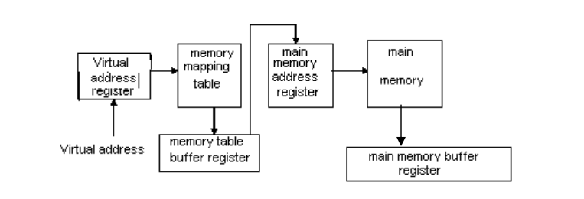
Figure 6: Virtual Memory

Slide 30
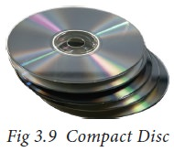
Secondary Storage Devices
A computer generally has limited amount of main memory which is expensive and volatile. To store data and programs permanently, secondary storage devices are used. Secondary storage devices serve as a supportive storage to main memory and they are non-volatile in nature, secondary storage is also called as Backup storage.
Hard Disks: Hard disk is a magnetic disk on which you can store data. The hard disk has the stacked arrangement of disks accessed by a pair of heads for each of the disks. The hard disks come with a single or double sided disk.
2. Compact Disc (CD): A CD or CD-ROM is made from 1.2 millimeters thick, polycarbonate plastic material. A thin layer of aluminum or gold is applied to the surface.CD data is represented as tiny indentations known as "pits", encoded in a spiral track moulded into the top of the polycarbonate layer. The areas between pits are known as "lands". A motor within the CD player rotates the disk. The capacity of an ordinary CD-ROM is 700MB.

Slide 31
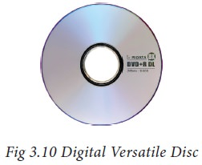
3. Digital Versatile Disc (DVD)
A DVD (Digital Versatile Disc or Digital Video Disc) is an optical disc capable of storing up to 4.7 GB of data, more than six times what a CD can hold. DVDs are often used to store movies at a better quality. Like CDs, DVDs are read with a laser.
The disc can have one or two sides, and one or two layers of data per side; the number of sides and layers determines how much it can hold. A 12 cm diameter disc with single sided, single layer has 4.7 GB capacity, whereas the single sided, double layer has 8.5 GB capacity. The 8 cm DVD has 1.5 GB capacity. The capacity of a DVD-ROM can be visually determined by noting the number of data sides of the disc. Double-layered sides are usually gold-coloured, while single-layered sides are usually silver-coloured, like a CD.

Slide 32
4. IDE (Integrated Drive Electronics): Integrated Drive Electronics (IDE) is a standard interface for connecting a motherboard to storage devices such as hard drives and CD-ROM/DVD drives. The original IDE had a 16-bit interface that connected two devices to a single-ribbon cable. This cost-effective IDE device carried its own circuitry and included an integrated disk drive controller. Prior to IDE, controllers were separate external devices. IDE’s development increased data transfer rate (DTR) speed and reduced storage device and controller issues. IDE is also known as Advanced Technology Attachment (ATA) or intelligent drive electronics (IDE).
5. SCSI (Small Computer System Interface): A small computer systems interface (SCSI) is a standard interface for connecting peripheral devices to a PC. Depending on the standard, generally it can connect up to 16 peripheral devices using a single bus including one host adapter. SCSI is used to increase performance, deliver faster data transfer transmission and provide larger expansion for devices such as CD-ROM drives, scanners, DVD drives and CD writers. SCSI is also frequently used with RAID, servers, high-performance PCs and storage area networks SCSI has a controller in charge of transferring data between the devices and the SCSI bus. It is either embedded on the motherboard or a host adapter is inserted into an expansion slot on the motherboard. The controller also contains SCSI basic input/output system, which is a small chip providing the required software to access and control devices. Each device on a parallel SCSI bus must be assigned a number between 0 and 7 on a narrow bus or 0 and 15 on a wider bus. This number is called an SCSI ID. Newer serial SCSI IDs such as serialattached SCSI (SAS) use an automatic process assigning a 7-bit number with the use of serial storage architecture initiators.

Slide 33
SCSI Bus Interface
Overview
The small computer system interface operates locally as an input and output (I/O) bus that uses a common command set to transfer controls and data to all devices. The main purpose of this interface, called the SCSI bus, is to provide host computer systems with connections to a variety of peripheral devices, including disk subsystems, tape subsystems, printers, scanners, optical devices, communication devices, and libraries. The SCSI bus design for the library provides a peer-to-peer, I/O interface that supports up to 16 devices and accommodates multiple hosts.
Peer-to-peer interface communication can be from:
Host to host
Host to peripheral device
Peripheral device to peripheral device

Slide 34
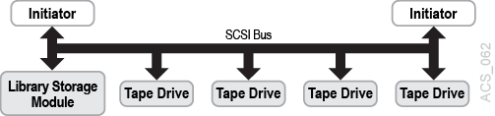
SCSI terms defining communication between devices on the SCSI bus include:
Initiator is the device that requests an operation.
Target is the device that performs the operation requested.
Some targets are control units that can access one or more physical or virtual peripheral devices addressable through the control unit.These peripheral devices are called logical units and are assigned specific addresses or logical unit numbers (LUNs). The library supports SCSI-3 commands.The library and the tape drives have separate connections for attachment to the SCSI bus. Daisy-chain cables are available to interconnect devices on the SCSI bus but keep the total cable length to a minimum. The following figure shows an example of a library and four tape drives that are daisy-chained to two initiators (or hosts).It is recommended that the drives be connected to a separate SCSI bus from the library.
Figure 1-1 Example of a Library Configuration on the SCSI Bus

Slide 35
Benefits
A small computer system interface also provides these benefits:
Low overhead
High transfer rates
A high-performance buffered interface
Conformance to industry standards
Plug compatibility for easy integration
Error recovery, parity, and sequence checking provides high reliability
Provisions in the command set for vendor-unique fields
Standard or common command sets with an intelligent interface that provides device independence

Slide 36
6. RAID (Redundant Array of Inexpensive Disks):
RAID or redundant array of independent disks is a data storage virtualization technology that combines multiple physical disk drive components into one or more logical units for data redundancy, performance improvement, or both.
It is a way of storing the same data in different places on multiple hard disks or solid-state drives to protect data in the case of a drive failure. A RAID system consists of two or more drives working in parallel. These can be hard discs, but there is a trend to use SSD technology (Solid State Drives).
RAID combines several independent and relatively small disks into single storage of a large size. The disks included in the array are called array members. The disks can combine into the array in different ways, which are known as RAID levels. Each of RAID levels has its own characteristics of:
Fault-tolerance is the ability to survive one or several disk failures.
Performance shows the change in the read and writes speed of the entire array compared to a single disk.
The array's capacity is determined by the amount of user data written to the array. The array capacity depends on the RAID level and does not always match the sum of the RAID member disks' sizes. To calculate the particular RAID type's capacity and a set of member disks, you can use a free online RAID calculator.
RAID systems can use with several interfaces, including SATA, SCSI, IDE, or FC (fiber channel.) Some systems use SATA disks internally but that have a FireWire or SCSI interface for the host system.

Slide 37
Thank you

